Slide 1
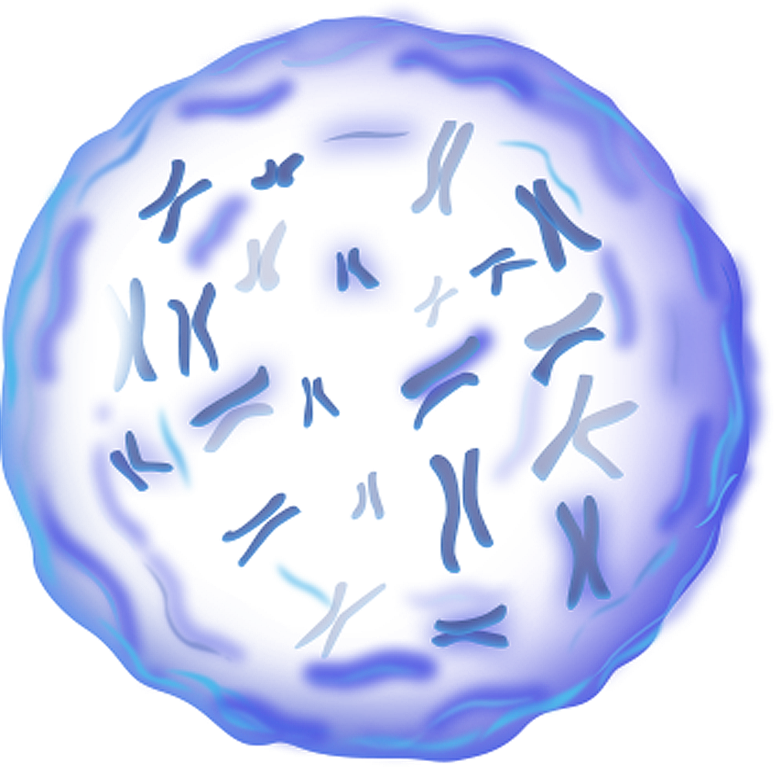
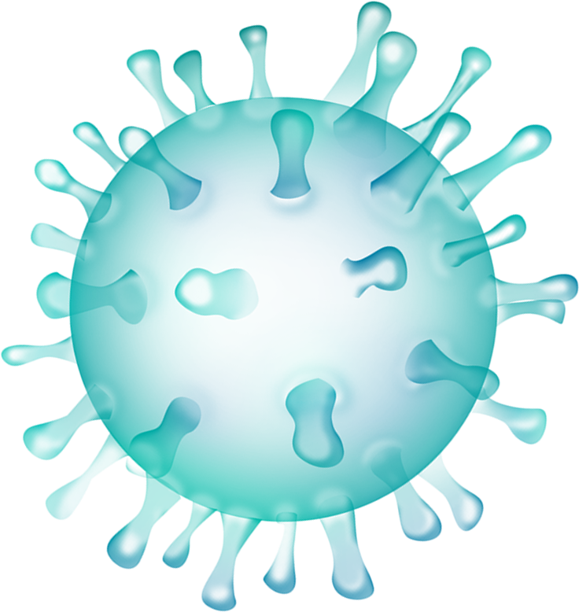

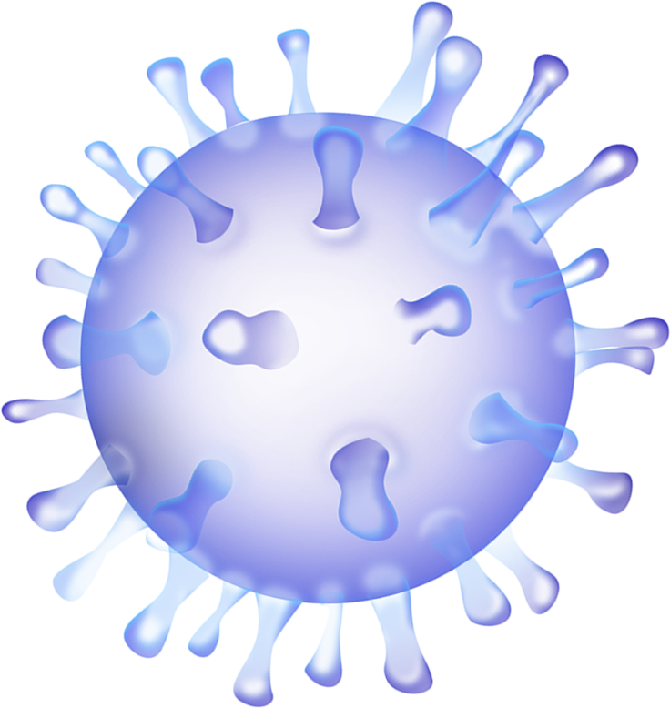
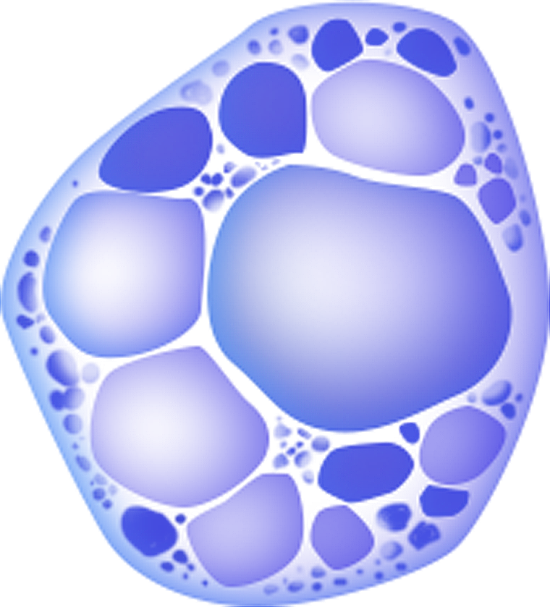
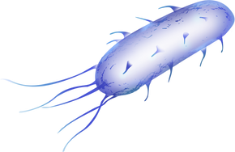
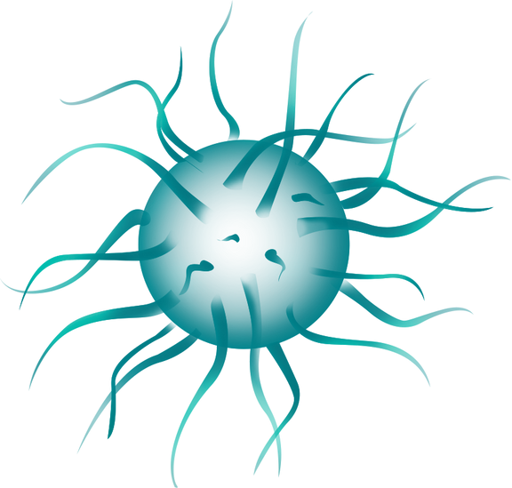
IMMUNE SYSTEM

Slide 2
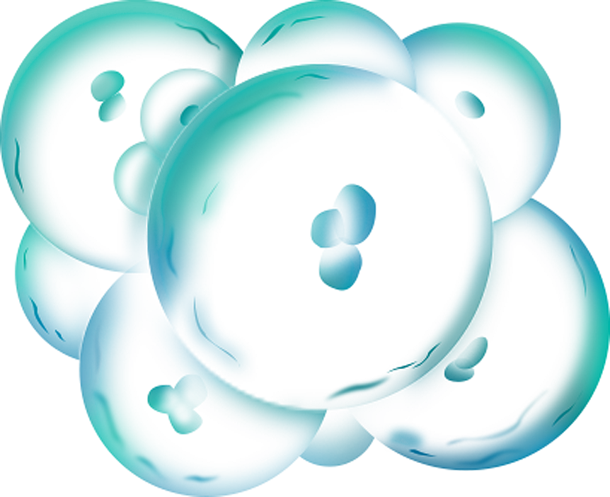
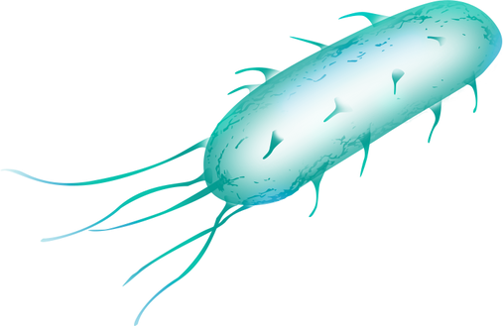
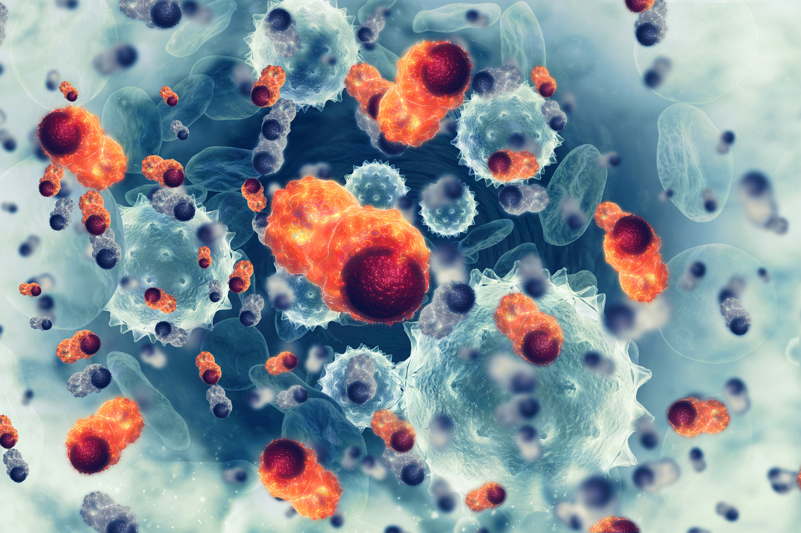
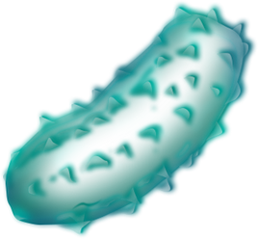
Introduction
The immune system is a complex and highly organized network of cells, tissues, and organs in the human body that plays a vital role in defending against infections, diseases, and foreign invaders. Its primary function is to recognize and neutralize harmful substances, such as bacteria, viruses, fungi, parasites, and even cancer cells, while also helping to maintain the body's overall health and prevent autoimmune reactions (where the immune system mistakenly attacks the body's own healthy cells).

Slide 3
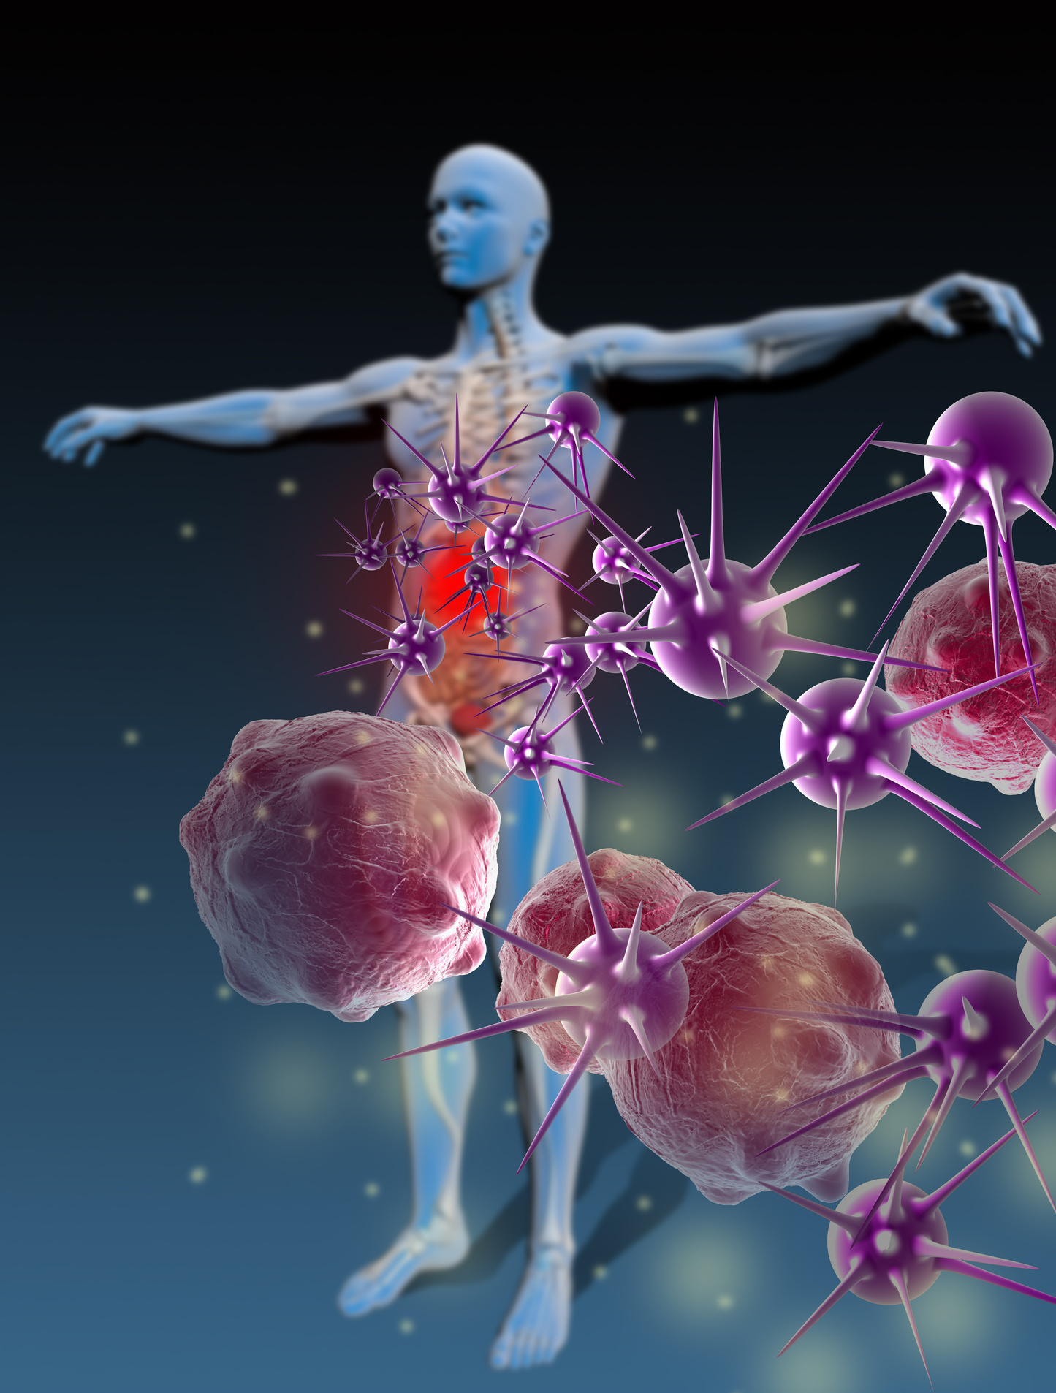
The immune system comprises two main components:
01
Innate Immunity:
This is the body's first line of defense, and it provides immediate, non-specific protection against a wide range of pathogens. Innate immunity includes physical barriers like the skin and mucous membranes, as well as various immune cells such as macrophages, neutrophils, and natural killer cells. These cells work to identify and eliminate pathogens and activate inflammation responses. Innate immunity is present from birth and does not require prior exposure to a specific pathogen to be effective.
02
Adaptive Immunity:
Also known as acquired immunity, this component is highly specific and develops over time as the body encounters various pathogens. The adaptive immune system remembers previous encounters with pathogens and can mount a more targeted and efficient response upon re-exposure. Key players in the adaptive immune system are B cells and T cells, which produce antibodies and coordinate immune responses. Antibodies are proteins that can specifically recognize and bind to pathogens, marking them for destruction.

Slide 4
The immune system function
01
01
Detection:
02
Immune cells and receptors recognize the presence of foreign substances, such as antigens on the surface of pathogens. These antigens act as "red flags" that trigger the immune response.
02
Activation:
03
Once a pathogen is detected, immune cells and proteins are activated to respond. In the case of adaptive immunity, B cells and T cells are activated to produce antibodies and coordinate an immune response.
03
Response
Immune cells and molecules work together to eliminate the invading pathogen. This may involve phagocytosis (engulfing and digesting the pathogen), the release of toxic molecules, and the recruitment of more immune cells to the site of infection.
04
04
Memory:
After the infection is resolved, the adaptive immune system "remembers" the pathogen, creating a pool of memory cells that can mount a quicker and more effective response if the same pathogen is encountered in the future.

Slide 5
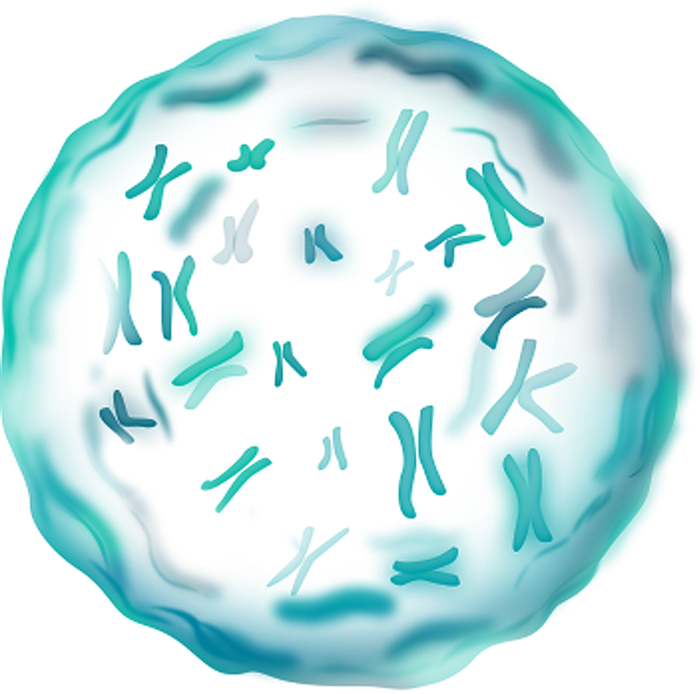
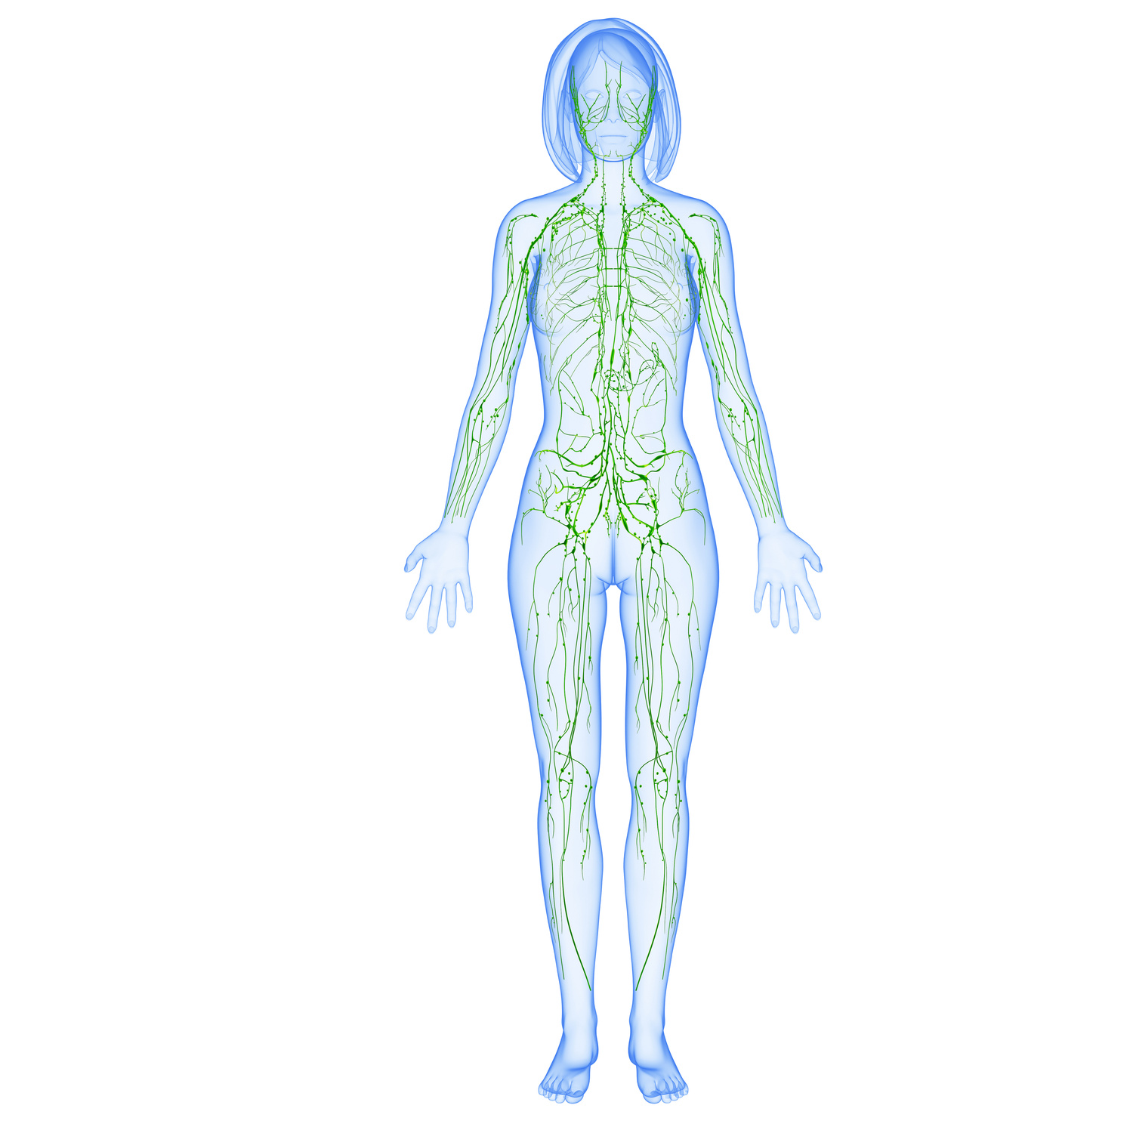

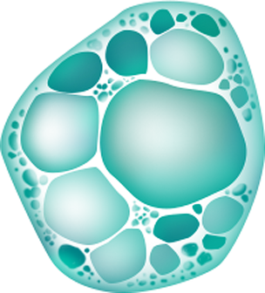
Lymphatic System
Introduction
The lymphatic system is a complex network of vessels, nodes, organs, and tissues that plays a vital role in maintaining fluid balance, immune function, and the circulation of various substances throughout the body. It is a critical part of the immune system and has several

Slide 6
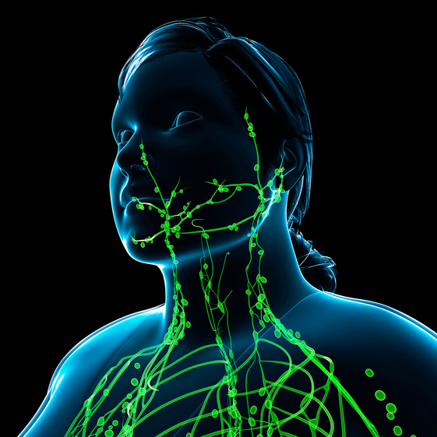
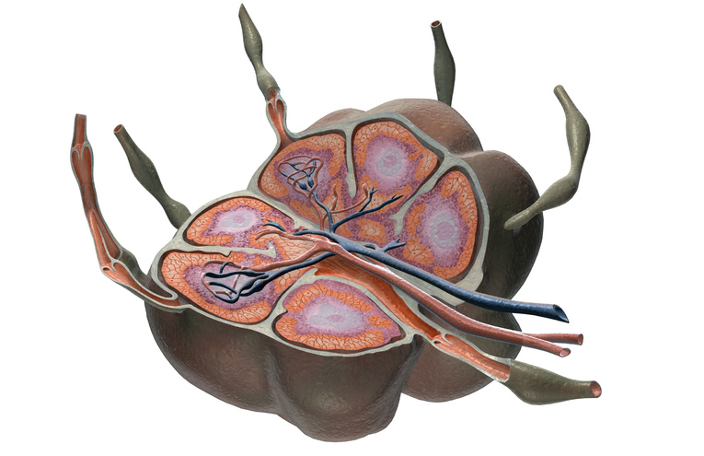
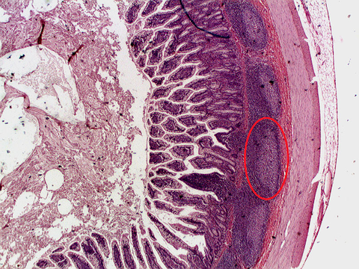
Components:
Lymphatic Vessels:
Lymph Nodes
Spleen
Description
Description
Description
These thin-walled vessels form a network that runs throughout the body, parallel to the circulatory system's blood vessels. Lymphatic vessels collect excess interstitial fluid, which is then called lymph, and transport it towards larger lymphatic vessels and lymph nodes.
Lymph nodes are small, bean-shaped structures distributed throughout the body, usually clustered in regions like the neck, armpits, and groin. They act as filtration and immune activation sites, where lymph is filtered to remove pathogens, dead cells, and debris, while immune cells interact to mount immune responses.
The spleen is an organ located in the upper left abdomen. It acts as a blood filter and reservoir for immune cells, particularly white blood cells (lymphocytes). It plays a role in monitoring and responding to bloodborne infections.

Slide 7
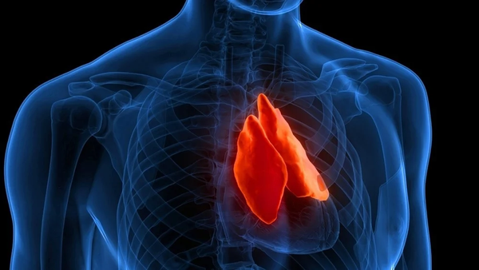
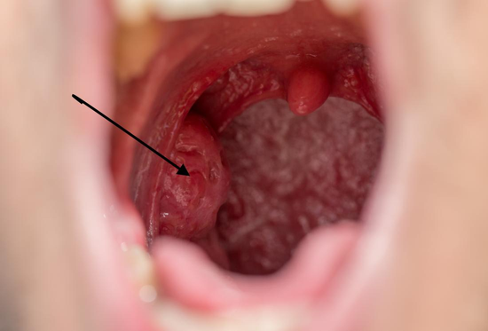
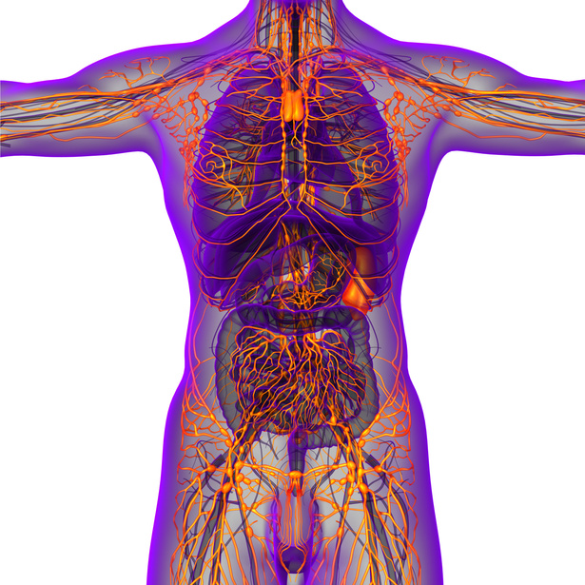
Components:
Thymus:
Tonsils and Adenoids:
Peyer's Patches
Description
Description
Description
The thymus is a gland located in the chest, above the heart. It is crucial for the maturation and development of T lymphocytes (T cells), which are important for cell-mediated immunity.
These are collections of lymphoid tissue found in the throat and the back of the nasal cavity, respectively. They help protect against respiratory and oral infections.
Peyer's Patches and Mucosa-Associated Lymphoid Tissue (MALT): These are lymphoid tissues found in the mucous membranes of the gastrointestinal and respiratory tracts. They play a role in immune responses against pathogens that enter the body through these routes.

Slide 8
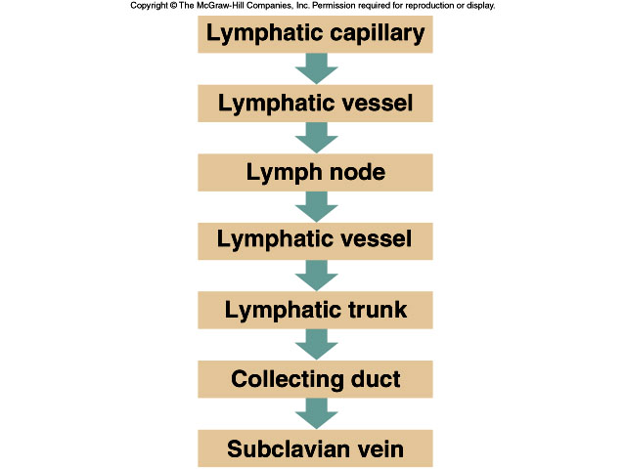
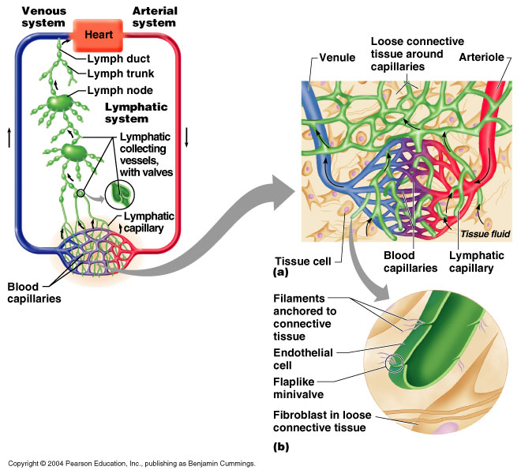
Flow:

Slide 9
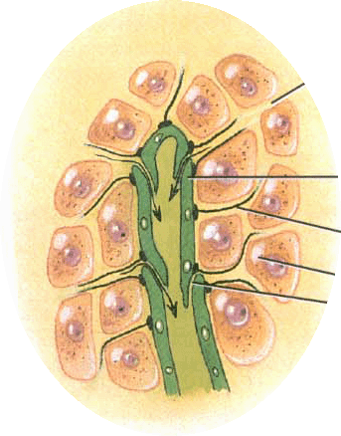
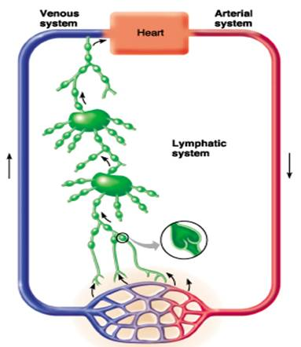
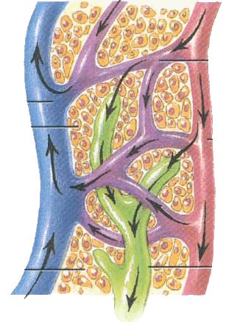
Flow:

Slide 10
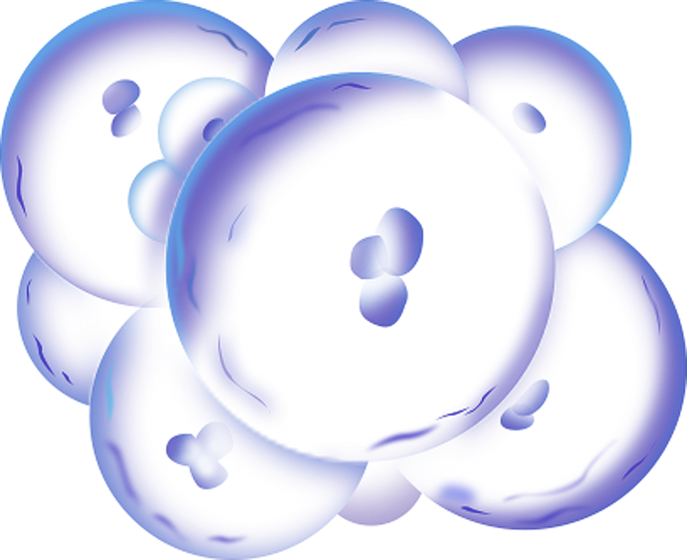
Functions
Transport of Immune Cells and Antigens:
Absorption of Dietary Fat:
Fluid Balance:
Immune Response:
The lymphatic system helps maintain fluid balance in the body by collecting excess interstitial fluid (the fluid that surrounds cells and tissues) and returning it to the bloodstream. This prevents the accumulation of excess fluid, which can lead to edema (swelling).
The lymphatic system is a key component of the body's immune defense. Lymph nodes, which are small, bean-shaped structures located along lymphatic vessels, are crucial sites for immune cell activation and interaction. Lymph nodes contain immune cells such as lymphocytes and macrophages that help identify and fight infections.
The lymphatic system also plays a role in the absorption of dietary fats from the intestines. Specialized lymphatic vessels called lacteals in the small intestine absorb fats and fat-soluble vitamins, transporting them to the bloodstream for distribution to cells throughout the body.
Lymphatic vessels carry immune cells, antigens (foreign substances like pathogens), and antibodies to lymph nodes, where immune responses are initiated. This enables the immune system to recognize and respond to pathogens and other threats.

Slide 11

VACCINES ARE MEDICAL PRODUCTS DESIGNED TO STIMULATE THE IMMUNE SYSTEM AND PROVIDE IMMUNITY AGAINST SPECIFIC INFECTIOUS DISEASES. THEY CONTAIN WEAKENED, INACTIVATED, OR PIECES OF THE PATHOGEN (E.G., BACTERIA, VIRUS, OR TOXIN) THAT CAUSES THE TARGETED DISEASE. WHEN A PERSON IS VACCINATED
THEIR IMMUNE SYSTEM IS EXPOSED TO THESE HARMLESS VERSIONS OF THE PATHOGEN, WHICH TRIGGERS AN IMMUNE RESPONSE WITHOUT CAUSING THE DISEASE ITSELF. THIS PRIMES THE IMMUNE SYSTEM TO RECOGNIZE AND FIGHT THE PATHOGEN IF THE PERSON IS EXPOSED TO IT IN THE FUTURE.

Slide 12
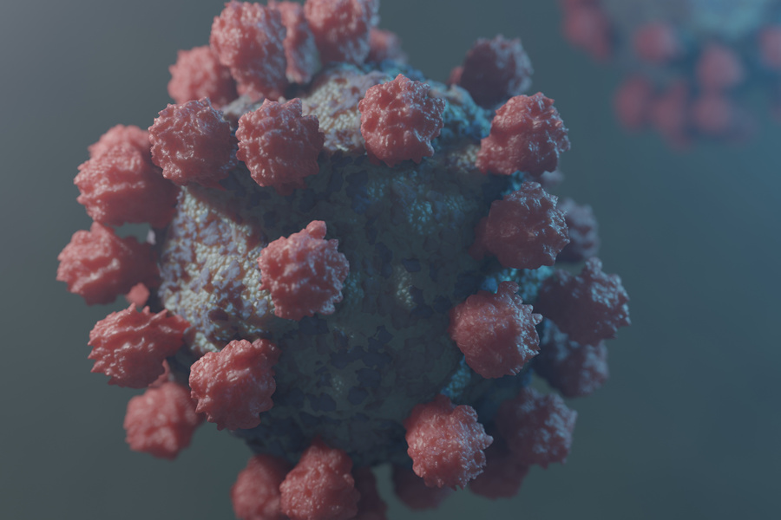
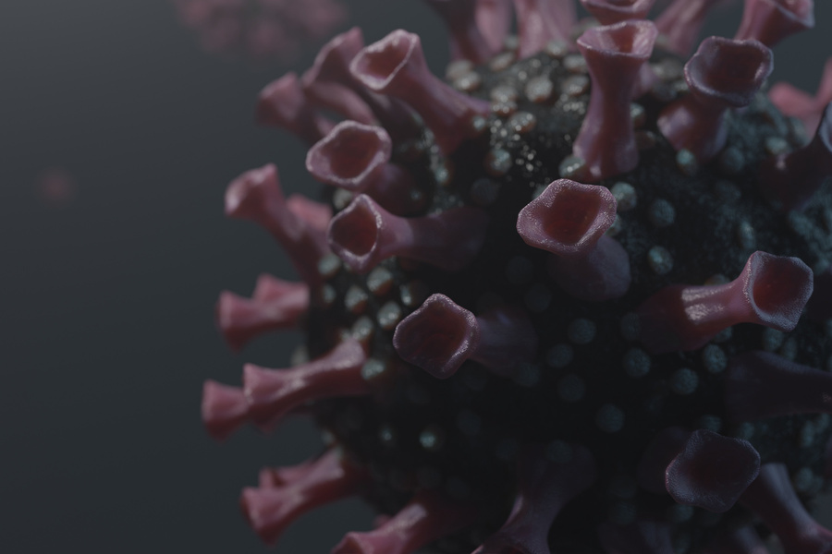
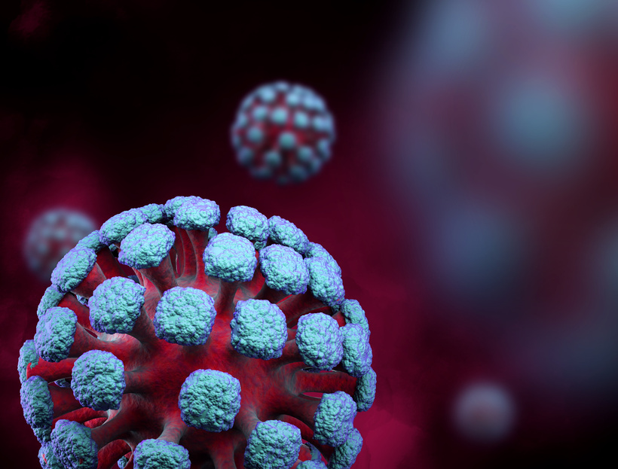
Types of Vaccines
Live Attenuated Vaccines:
These vaccines contain a weakened form of the live pathogen. Examples include the measles, mumps, and rubella (MMR) vaccine and the oral polio vaccine.
Vaccination is a critical public health tool, and the widespread adoption of vaccines has been instrumental in reducing the burden of many infectious diseases. It is essential for individuals to follow vaccination schedules recommended by healthcare providers to protect themselves and their communities from preventable diseases.
Inactivated or Killed Vaccines
These vaccines contain pathogens that have been killed or inactivated, making them unable to cause disease. Examples include the polio vaccine (injected version) and the hepatitis
mRNA Vaccines
These vaccines, like the COVID-19 vaccines developed by Pfizer-BioNTech and Moderna, use a small piece of genetic material (messenger RNA) to instruct cells to produce a harmless piece of the pathogen's surface, prompting an immune response.

